Slide 1
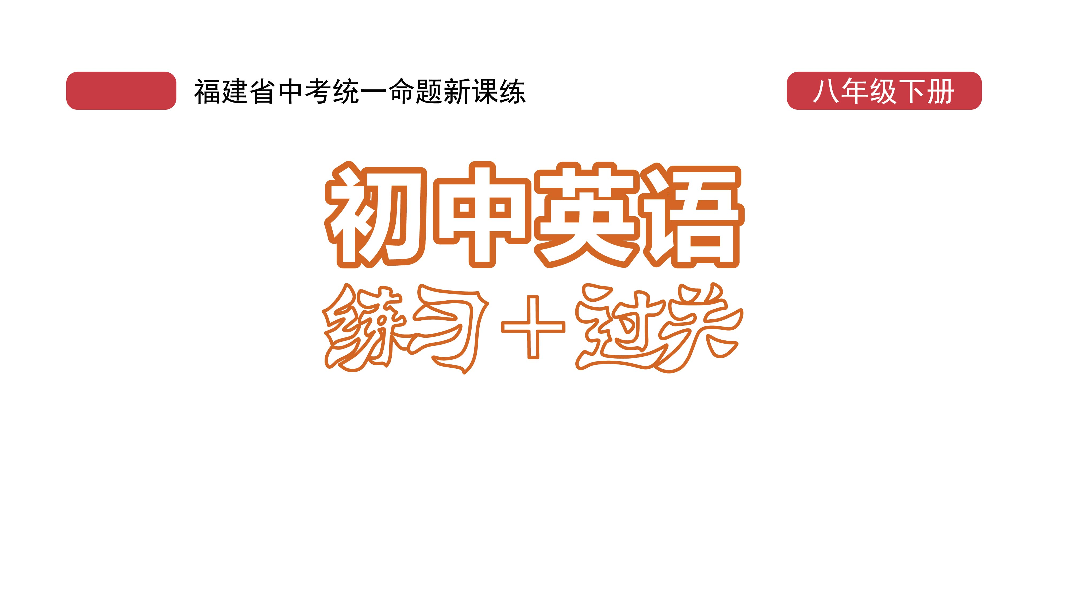
过关测试卷
期中测试卷

Slide 2
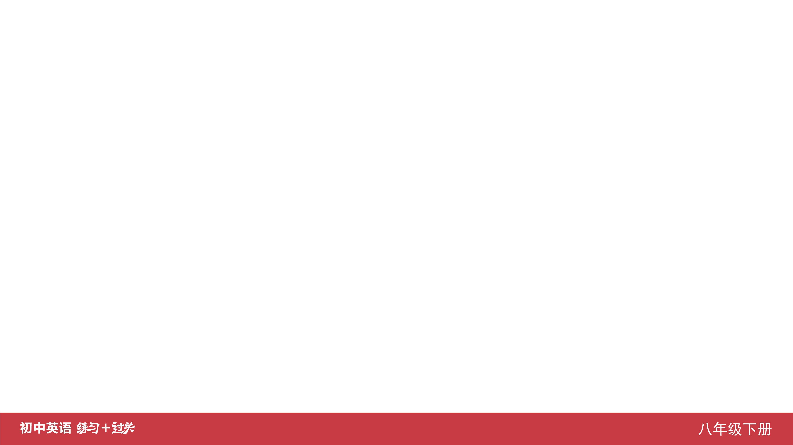
Ⅰ. 听力
1-5 ____________
6-10 ____________
11-15 ____________
16 ____________
17 ____________
18 ____________
19 ____________
20 ____________
CCBBA
ACBAB
CCABB
April
practiced
ten/10
ice
hardest

Slide 3
Ⅱ. 选择填空
21-25 ____________
26-30 ____________
31-35 ____________
BAABA
BBCAC
BBCAC

Slide 4
Ⅲ. 完形填空
36-40 ____________
41-45 ____________
ABBBC
ABCAC

Slide 5
Ⅳ. 阅读理解
46-50 ____________
51-55 ____________
56-60 ____________
61-65 ____________
66-70 ____________
DAABC
DBDBA
CBADB
ABBCD
DAEBC

Slide 6
Ⅴ. 情景交际
71. ____________________________________________
72. ____________________________________________
73. ____________________________________________ 74. ____________________________________________
____________________________________________ 75. ____________________________________________
____________________________________________
Why does Tom look unhappy?
How do you like/What do you think of the song, Bob?
How much does it cost to get to Shenyang by plane?
Can you tell me how to deal with the/these old newspapers?
You should wear a helmet when riding/when you ride a bike.

Slide 7
Ⅵ. 看图写话
76. ___________________________________________
77. ___________________________________________
78. ___________________________________________
___________________________________________
The box is full of books.
The girl/She heard from her parents yesterday.
Listening to music makes the boy relaxed./
Music can make him relaxed.

Slide 8
Ⅵ. 看图写话
79. ______________________________________________
______________________________________________
80. ______________________________________________
______________________________________________
The mother looks/is worried because her daughter is ill (in bed).
The man/He didn’t (go to) sleep until 11 o’clock (last night).

Slide 9
Ⅶ. 短文填空
common
so/and
a
slowly
as
direction
noticed
dangerous
safety
carry
81 ____________
82 ____________
83 ____________
84 ____________
85 ____________
86 ____________
87 ____________
88 ____________
89 ____________
90 ____________

Slide 10
Ⅷ. 书面表达
Dear Betty,
I’m sorry to hear that you didn’t do well in your Chinese exam.
As we know, Chinese is difficult to learn, so just take it easy. Here are my suggestions on learning Chinese well. First, you should listen to the teacher more carefully in class. Second, reading is important for learning a language, so read as much as you can. You can begin with some interesting novels like Journey to the West. Third, don’t be shy and practice speaking Chinese as often as possible.

Slide 11
Ⅷ. 书面表达
Yours,
Anna
I’m sure if you work much harder at Chinese, you’ll do better next time. Believe in yourself.

Slide 12
